Slide 1


Motion controlled virtual mouse
Kle dr. m. s. Sheshgiri College of engg. & tech
Team Code: CEVI2021SWP021
Using Python & opencv
Muhammad Huzaifa
Dhiraj Inchalkaranji

Slide 2
O V E R V I E W
OBJECTIVE
INTRODUCTION
PROBLEM STATEMENT
METHOLOGY
RESULTS
conclusion
REFERENCE

Slide 3
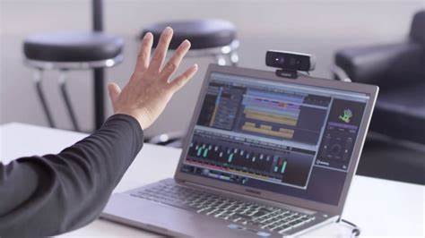
PROJECT OBJECTIVE
The objective is to manage computers and other devices with gestures rather than pointing and clicking a mouse or touching display directly.

Slide 4
INTRODUCTION
As a computer technology continues to develop, people have smaller and small electronic devices.
There is no more popular navigation or interaction device other than mouse.
In our project, we propose a novel approach that uses a video device to control mouse system (mouse tasks).

Slide 5
Problem statement
To design vision based mouse which detects hand gestures patterns instead of physical mouse.
The camera is positioned such that it recognizes the motion of finger tips and performs the operations of mouse.

Slide 6





Python Libraries in use
OpenCV
autopy
MediaPipe
NumPy
PyAutoGUI
Provides a real-time optimized Computer Vision library, tools, and hardware.
It includes functions for controlling the keyboard and mouse.
Offers cross platform, customizable ML solutions for live and streaming media.
Offers comprehensive mathematical functions, random number generators, linear algebra routines, Fourier transforms, and more.
It is a cross-platform GUI automation Python module. Used to programmatically control the mouse and keyboard

Slide 7
Methodology
Point and move
index finger
True
Mouse cursor moving
START
Image acquisition
(webcam)
Bring index & middle finger closer
True
Performs left click (double click)
Hand detection
Bring index, middle & ring finger closer
True
Performs right click
After hand detection, mark key points on finger tips
Point palm
(with all fingers)
True
Performs scroll down
Point palm with thumb closed
True
Performs scroll up
Distance between index & thumb is varied
True
Increases / decreases volume

Slide 8
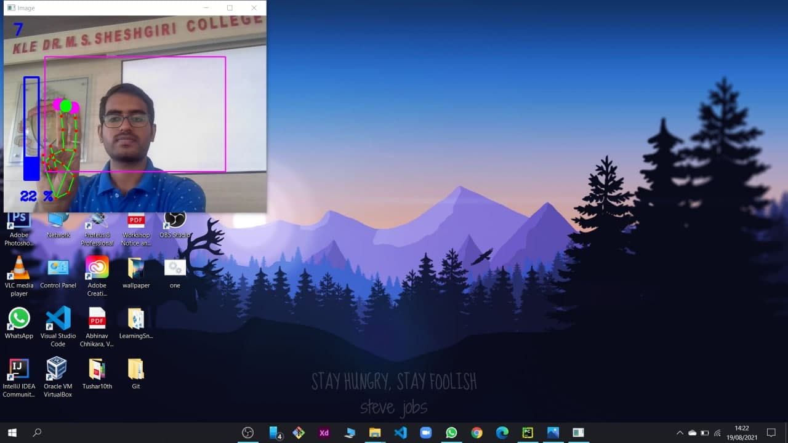
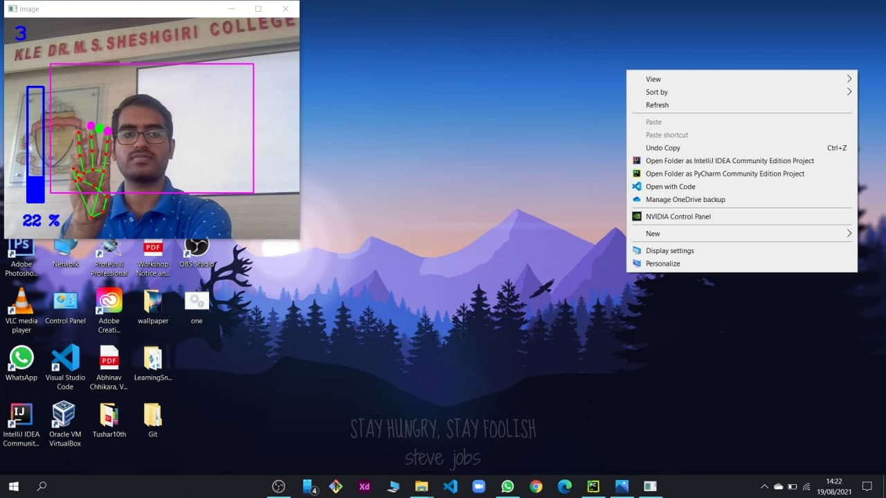
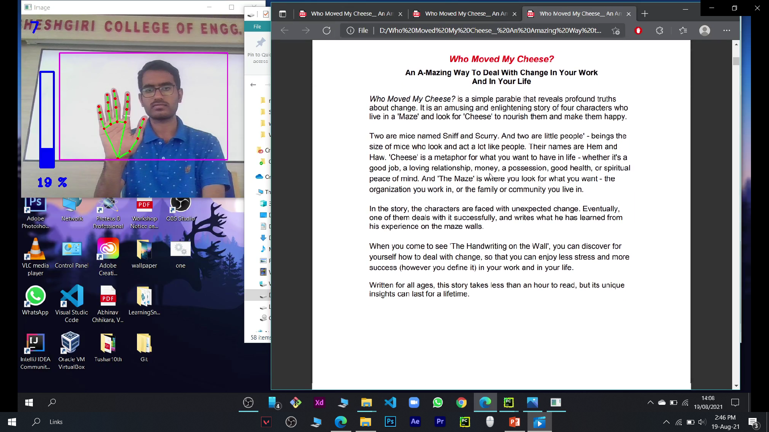
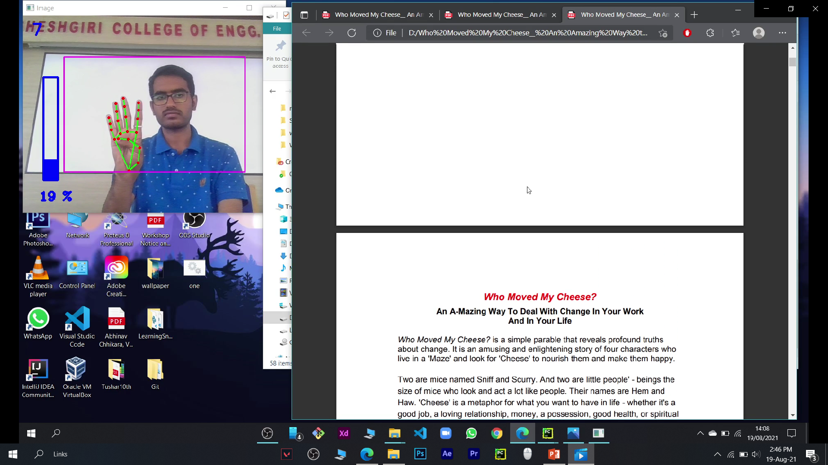
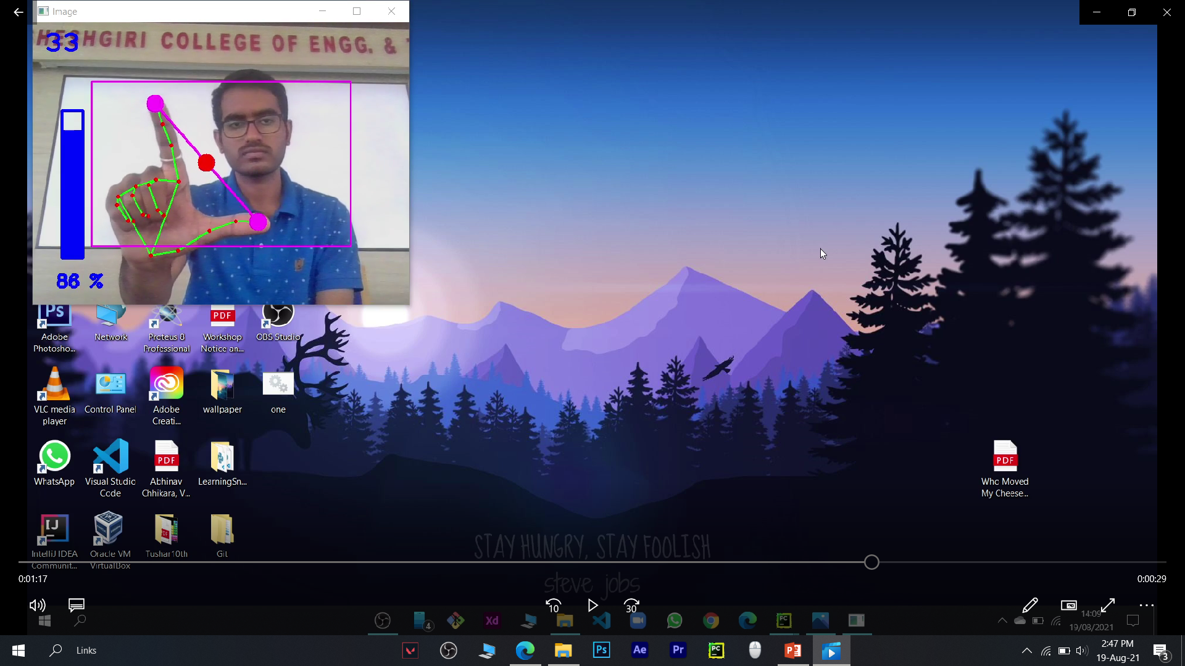

Results
1. Left click
2. Right click
3. Scroll down
4. Scroll down
5. Volume up
6. Volume down

Slide 9
Conclusion
We are developing a system to control the mouse cursor using a real-time camera.
This system is based on computer vision algorithm and can do all mouse tasks.
This system could be useful in presentations and to reduce workspace.
Also this would lead to a new era of Human Computer Interaction (HCI) where no physical contact with the device is required.

Slide 10
References
https://google.github.io/mediapipe/solutions/hands#python-solution-api
https://www.autopy.org/documentation/api-reference/mouse.html
https://www.youtube.com
https://pyautogui.readthedocs.io/en/latest/mouse.html

Slide 11
THANK YOU

